Slide 1

Pennant Technologies Private Limited
JDBC Scrollable and Updatable set

Slide 4
Scrollable ResultSet
Whenever we create an object of ResultSet by default, it allows us to retrieve in forward direction only and we cannot perform any modifications on ResultSet object.
Therefore, by default the ResultSet object is non-scrollable and non-updatable ResultSet.
Scrollable ResultSet:
A scrollable ResultSet is one which allows us to retrieve the data in forward direction as well as backward direction but no updations are allowed.
In order to make the non-scrollable ResultSet as scrollable ResultSet as scrollable ResultSet we must use the following createStatement which is present in Connection interface.
Examples: Statement st=con.createStatement (ResultSet.TYPE_SCROLL_INSENSITIVE, ResultSet.CONCUR_READ_ONLY);
ResultSet rs=st.executeQuery ("select * from student");

Slide 5
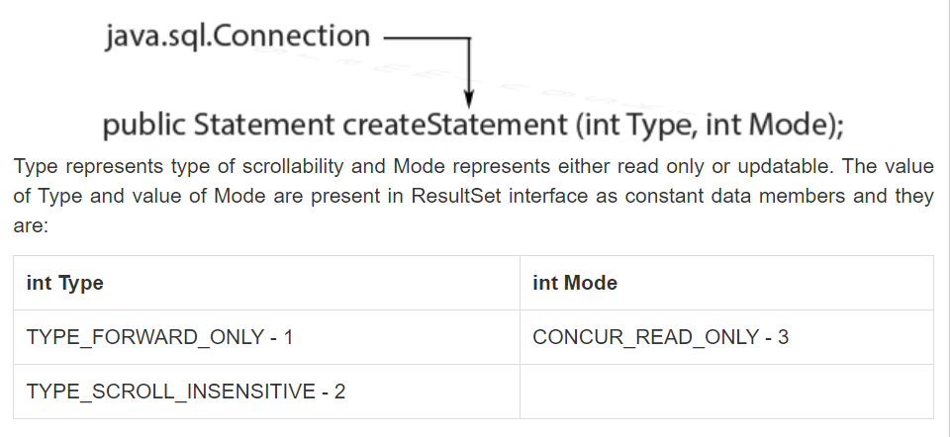

Slide 6
Scrollable Resultset in JDBC
In Jdbc ResultSet Interface are classified into two type;.
Non-Scrollable ResultSet in JDBC
Scrollable ResultSet
By default a ResultSet Interface is Non-Scrollable, In non-scrollable ResultSet we can move only in forward direction (that means from first record to last record), but not in Backward Direction, If you want to move in backward direction use Scrollable Interface.
Create Scrollable ResultSet
To create a Scrollable ResultSet, create Statement object with two parameters.
Syntax Statement stmt=con.CreateStatement(param1, param2);
// parm1 type and param2 mode

Slide 7
These type and mode are predefined in ResultSet Interface of Jdbc like below which is static final.
Type: public static final int TYPE_FORWARD_ONLY=1003
public static final int TYPE_SCROLL_INSENSITIVE=1004
public static final int TYPE_SCROLL_SENSITIVE=1005
Mode: public static final int CONCUR_READ_ONLY=1007
public static final int CONCUR_UPDATABLE=1008
Note: To create Statement object we can pass either int value as parameter or their variable name.
Example: Statement stmt=con.CreateStatement(1004, 1007); or
Statement stmt=con.CreateStatement(ResutlSet.TYPE_SCROLL_INSENSITIVE, ResultSet.CONCUR_READ_ONLY);
Methods of Scrollable ResultSet Below all methods are used for move the cursor in Scrollable ResultSet.
afterLast Used to move the cursor after last row.
BeforeFirst: Used to move the cursor before first row.
previous: Used to move the cursor backward.
first: Used to move the cursor first at row.
last: Used to move the cursor at last row.

Slide 8
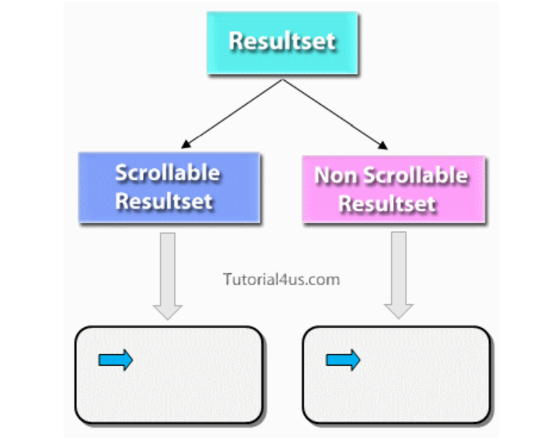

Slide 9
